Slide 1
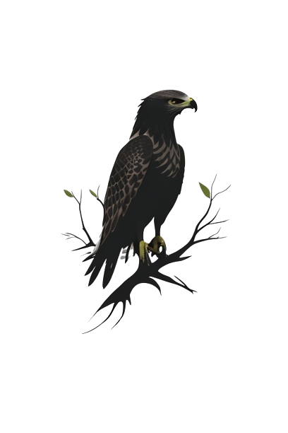
LANGUAGE OF THE POEM “HAWK ROOSTING”
-Ted Hughes

Slide 2
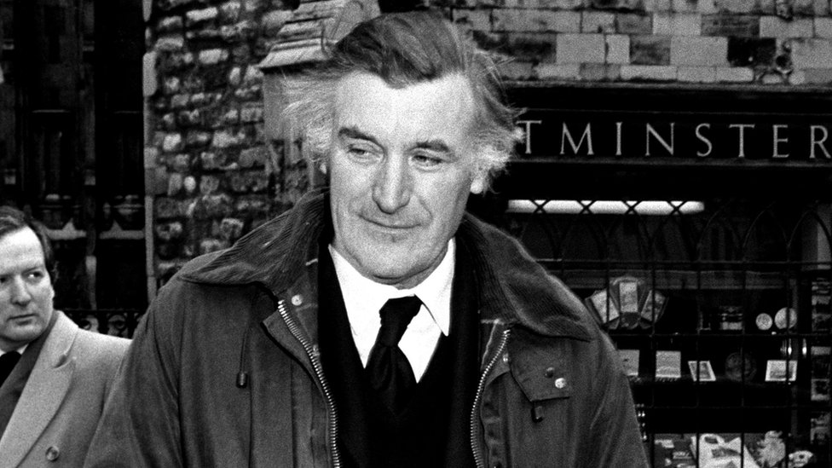
Ted hughes
Renowned Poet
Highly celebrated English poet.
Rural Dweller
Spent most of the time in rural areas.
Symbolic
The imperial Eagle- Nazi party symbol.
Playwright, translator, and children's author.
Poet Laureate of the UK from 1984 until his death.
Studied anthropology in university.
Also called “War poet once removed”
Did many jobs before poet, including working at zoo.
.
Introduction
Full Name: Ted Hughes (Edward James Hughes)
Early Life:
Hughes grew up in the countryside of Yorkshire, which deeply influenced his poetry.
Poetry
.
Known for his powerful and evocative imagery.
Frequently explored themes of nature, animals, and the human experience.
Major works include "Crow" (1970) and "Birthday Letters" (1998).
Often associated with the Confessional poetry movement.
Birth Date and Place: Born on August 17, 1930, in Mytholmroyd, Yorkshire, England.
Death Date: Died on October 28, 1998.
Studied at Mexborough Grammar School and Pembroke College, Cambridge.
He had a strong affinity for nature and animals from a young age.
.

Slide 3
OVERVIEW:
Literary Techniques:
Key Themes:
Imagery: Hughes employs vivid and striking imagery throughout the poem to paint a detailed picture of the hawk and its perspective.
Personification: The poem personifies the hawk, attributing human-like qualities to the bird.
Metaphor: The hawk's eye is metaphorically described as "hooked," emphasizing its sharp and predatory nature.
Power and Dominance: The poem delves deeply into the theme of power, presenting the hawk as an embodiment of dominance and control.
Nature's Brutality: Hughes portrays the natural world as ruthless and unforgiving.
Predator vs. Prey: The poem highlights the predator-prey relationship in the animal kingdom.

Slide 4
‘Hawk Roosting’
TITLE
The poem’s title begins with the noun ‘Hawk’.
What does it mean, and what does it therefore suggest about the Hawk?
What does that suggest about the birds' importance to the poem?
Roosting = Resting; Hawk feels comfortable, safe and in control.
Starting poem’s title with ‘Hawk’ emphasizes the bird’s importance to the poem.
Roosting = Resting
The hawk must feel comfortable, safe, and in control.

Slide 5
Perched in Solitude
01
The first-person perspective.
The Hawk control's the poem.
The Hawk physical position could indicate its power.
What does this mean, and what does it show about the hawk?
What could this image indicate?
I sit in the top of the wood, my eyes closed. Inaction, no falsifying dream
Between my hooked head and hooked feet: Or in sleep rehearse perfect kills and eat.
Falsifying = Fake or misleading
The hawk does not need (fake) dreams as its reality is perfect.
The repetition of hooked emphasizes the hawk’s potential for violence.
What does the repetition of ‘hooked’ emphasise?
What is the effect of this pronoun?
Rhyme emphasizes the idea it contains; the hawks kills are precise and perfect.
This is the poem’s only rhyming couplet. What is its effect?
What does this line tell us about the hawk?
The hawk thinks about killing even in sleep, emphasizing its power and violence .”Perfect” implies that iyt takes great pleasure from killing .

Slide 6
Perched in Solitude
01
What does this mean, and what does it show about the hawk?
What could this image indicate?
I sit in the top of the wood, my eyes closed. Inaction, no falsifying dream
Between my hooked head and hooked feet: Or in sleep rehearse perfect kills and eat.
The first-person perspective, the Hawk controls the poem.
What does the repetition of ‘hooked’ emphasise?
What is the effect of this pronoun?
This is the poem’s only rhyming couplet. What is its effect?
What does this line tell us about the hawk?

Slide 7
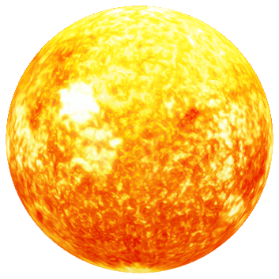
Killing Without Remorse
02
The hawk seems to think that the natural world has been designed just so suit it showing its arrogance.
The convenience of the high trees!
The air's buoyancy and the sun's ray
Are of advantage to me;
And the earth's face upward for my inspection.
How has language been used in this stanza to make the hawk sound arrogant?
The earth has been personified. By looking ‘upward’, it suggest that the hawk is above it both literally and hierarchically.
How does this word show that the hawk has power?
Inspectors have power over the things they inspect- they cast judgement and can punish.
The earth has been personified in this line. What is the effect of this?

Slide 8

03
Embracing the Height
My feet are locked upon the rough bark.
It took the whole of Creation
To produce my foot, my each feather:
Now I hold Creation in my foot
The hawk appears sturdy, as locks symbols of security and strength.
What does this image suggest about the hawk ? Why ?
What is the effect of this consonance.
The consonance emphasis the hawk’s firm, almost harsh grip.
Why is creation capitalized ?
Reference to God.
What do these lines mean? What do they suggest about the hawk?
The hawk thinks that it is a masterpiece, as it took all the God’s effort to create it.
What does this reveal about, what the hawk thinks about itself?
A reversal: The hawk thinks it is more powerful than God.

Slide 9
04
Oneness with Creation
The hawk's arrogance is highlighted as it thinks it can force ‘creation’ to do what its want’s.
Monosyllabic language suggests that the hawk is confident.
What is the effect of the monosyllabic language in this line?
Or fly up, and revolve it all slowly-
I kill where I please because it is all mine.
There is no sophistry in my body:
My manners are tearing off heads-
Why does this phrase highlight the hawk's arrogance?
What is the effect of the juxtaposition in this line?
The juxtaposition between politeness and violence presents the hawk as a dictator like figure.
The hawks say is final- nobody can convene it otherwise.
The line ends, just like the lives of the things it kills.
What does this image tell us about the hawk?
Violence does not phase the hawk. It likes the power.

Slide 10
05
The allotment of death. For the one path of my flight is direct Through the bones of the living. No arguments assert my right:
Unquestioned Authority
Double meaning:
The hawk gives out(allots) death. This emphasizes its power and arrogance and god-like status.
The hawk ‘grows’ death, as in an ‘allotment’. The juxtaposition is ironic and shows the hawk’s preoccupation with murder.
What could this mean?
The directness of the hawk’s path is mirrored in use of enjambment- not even the constraints of the poem can stop the hawk from doing what it wants.
What does the use of enjambment mirror?
What does this violent image reveal?
The hawk kills without mercy and believes it has power over life and death.

Slide 11
The sun is behind me. Nothing has changed since I began. My eye has permitted no change. I am going to keep things like this.
06
Unchanging Nature
The personification suggests that the sun supports the hawk, implying that it is right that hawk has so much power.
Each line of this stanza is a statement. They are expressed in a straightforward way, suggesting that the hawk is confident.
What is the effect of end-stopping each line in this stanza?
What is the effect of this personification
Why is this significant that this line starts with 'I'
This line starts in the same way as the first one – the hawk talks about itself a lot. It is egotistical.

Slide 12
SUMMARY
The narrative perspective of "Hawk Roosting" is first-person, as it is written from the viewpoint of the hawk.
The poem highlights the theme of control and dominance, emphasizing the hawk's unyielding authority and power in its environment.
Using straightforward words and phrases to convey the hawk's primal and uncomplicated perspective on power and dominance.
Hawk's Mindset
Imagery and Symbolism
Narrative Perspective
Dominance and Control
Simplicity of Language
Portraying its unapologetic dominance and sense of power in the natural world.
Imagery and symbolism are skillfully used to depict the hawk as a symbol of primal power and to create vivid mental images of its world.

Slide 13
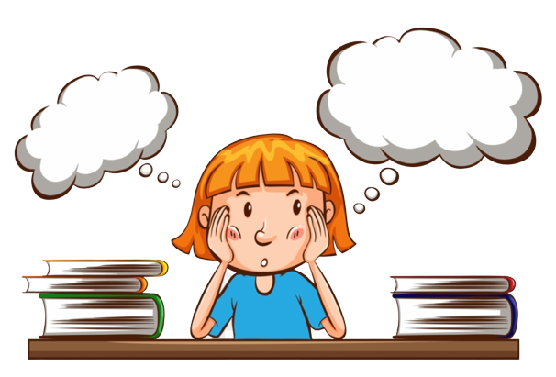

ANY QUESTIONS ?
Why does the hawk sound like it's giving a TED Talk on ego?
Is the hawk's viewpoint a commentary on human dominance over nature?

Slide 14
REFERENCES
Blog Posts/Online Articles:
"Hawk Roosting by Ted Hughes: Summary and Critical Analysis" on BachelorandMaster. (Provides an accessible analysis of the poem's language and meaning).
"Ted Hughes's 'Hawk Roosting'" on The English Blog. (Blog post analyzing the poem and Hughes's use of personification).
"Ted Hughes: Eco-Warrior and Master of Animals" on InterestingLiterature. (Blog discussing Hughes's animal poetry and connection to nature).
"Ted Hughes's 'Hawk Roosting' and a Confession" on Malahat Review. (Blog post reflecting personally on reading Hawk Roosting).
Gifford, Terry. Ted Hughes. Routledge, 2009. (Critical study examining Hughes's life and works).
Fuller, John. "Reflections on Hawk Roosting." The Ted Hughes Society Journal 1 (2011). (Article specifically analyzing Hawk Roosting and its language/meaning).

Slide 15
Thanks!
We extend our heartfelt gratitude to our wonderful classmates and our esteemed teacher for their attentive presence and support throughout our presentation. Your engagement and encouragement mean the world to us.
Thank you for being a part of this learning journey with us!
-Bharath, Lakshith, Ravi Tej, Lochan, Rohith.

